Slide 1
Employee Data Analysis using Excel
STUDENT NAME : VIDHYA SARASWATHI D K
REGISTER NO : 312216819 , 866871237A56D15A18C47360552218D6
DEPARTMENT : B.COM ACCOUNTING AND FINANCE
COLLEGE : SHRI KRISHNASWAMY COLLEGE FOR WOMEN

Slide 2
PROJECT TITLE
Employee Performance Analysis using Excel

Slide 3


AGENDA
Problem Statement
Project Overview
End Users
Our Solution and Proposition
Dataset Description
Modelling Approach
Results and Discussion
Conclusion

Slide 4

PROBLEM STATEMENT
Employee performance analysis enhances productivity and aligns individual efforts with organizational goals by identifying strengths, areas for improvement, and training needs.
It also supports informed decision-making regarding promotions, rewards, and development

Slide 5

PROJECT OVERVIEW
Employee performance analysis in an organization involves evaluating how effectively employees are meeting their job requirements and contributing to organizational goals.
It provides insights into strengths, areas for improvement, and training needs.
This process supports decision-making regarding promotions, rewards, and professional development.
In order to find the Trends and Pattern of different category of employee like high , medium , low.

Slide 6

WHO ARE THE END USERS?
Manager & Supervisor
HR Professional
Executives &Leadership
Employer
Employee

Slide 7

OUR SOLUTION AND ITS VALUE PROPOSITION
TECHNIQUE
Conditional Formatting
Filter
Formula
Pivot Table
Chart

Slide 8
Dataset Description
Employee Dataset
Features
Data Types
Download the employee dataset through KAGGLE website .
There are 26 features in the dataset and some of the dataset are highlighted.
Numerical Data
Text Data.

Slide 9

THE "WOW" IN OUR SOLUTION
IFS FORMULA
(IFS(Z8>=5,"Very High",Z8>=4,"High",Z8>=3,"Medium",TRUE,"Low")), 1, 1)
3/21/2024 Annual Review
9

Slide 10
MODELLING
Visualization
Summary
Performance Level
Data Cleaning
Feature Collection
Data Collection
10

Slide 11
MODELLING
Data collection involves gathering and measuring information from various sources to inform analysis and decision-making.
Feature collection involves identifying and extracting relevant attributes or characteristics from data for use in analysis, modeling, or machine learning.
Data cleaning in Excel involves identifying and correcting errors, inconsistencies, and inaccuracies in datasets to ensure accurate and reliable analysis.
Performance level refers to the measure of how well an individual, team, or system achieves its goals or objectives, often assessed through metrics or benchmarks.
A summary provides a concise overview of the main points or key information from a larger body of content, highlighting essential details and findings.
Visualization involves creating graphical representations of data, such as charts or graphs, to make complex information easier to understand and analyze.
11

Slide 12
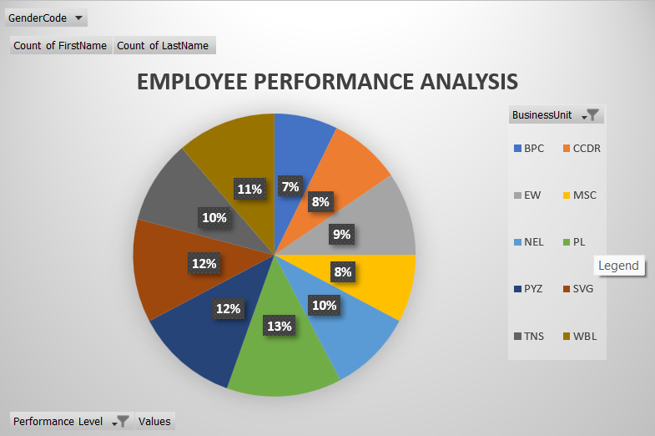
RESULTS
12

Slide 13
conclusion
In conclude that in the above employee dataset , the PL department contribution is higher.

